Slide 1


Slide 2
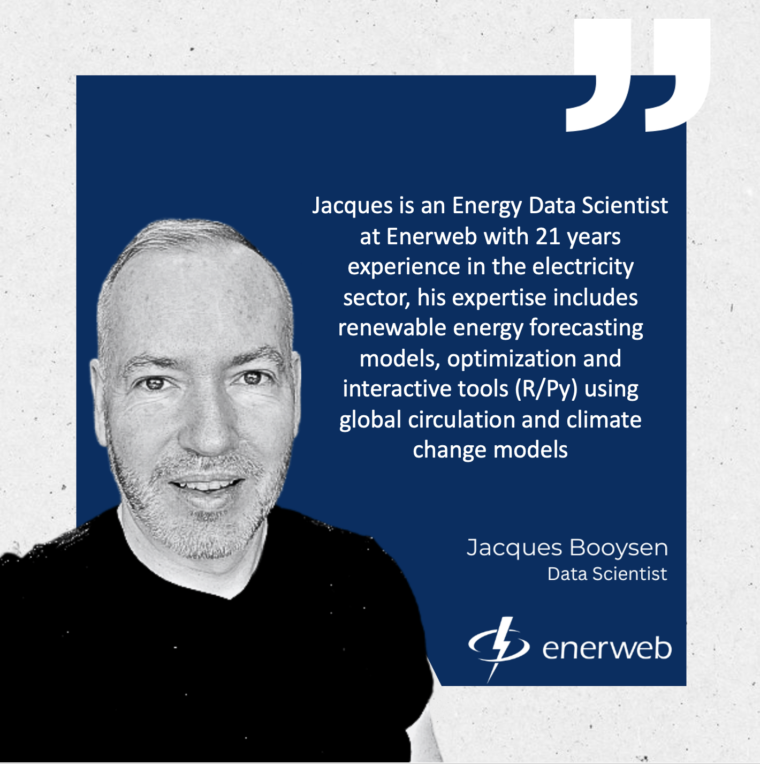
About me
I have a passion and love for:
Mountain Sport, Volcanos and Outdoor Adventure
My Family, proud husband and dad of 2 little ones 5 and 2, they outsmart me all the time.
Data Science, the Electricity Sector and Load Research

Slide 3

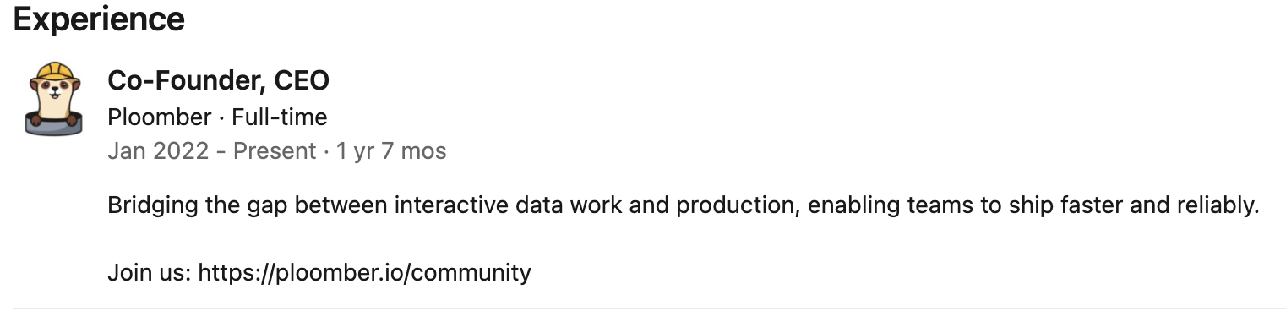

Credits / References
Note: I am no expert at Ploomber, I recently started using it and started exploring the R support and will share it in this presentation.
I must give credits as I reused some slides from:
Eduardo Blancas- Streamline your Data Science projects with Ploomber | JupyterCon 2020
Eduardo Blancas Ploomber CEO and founder
Notebooks as Functions with Matthew Seal (Netflix)

Slide 4

Data Science is all about experimentation
•
Three stages for each experiment:
Thinking
Coding
Execution
More experiments = higher chance of
success
•

Slide 5




Exploring and Prototyping.
Notebook
explore
Data Scientist
analyze

Slide 6
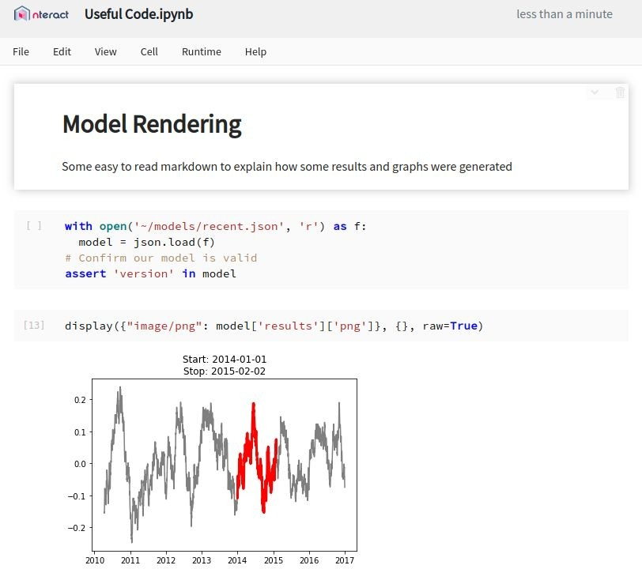

Notebooks.
A rendered REPL (Read-Eval-Print Loop) combining
Code
Logs
Documentation
Execution Results.
Useful for
Iterative Development
Sharing Results
Integrating Various API Calls

Slide 7

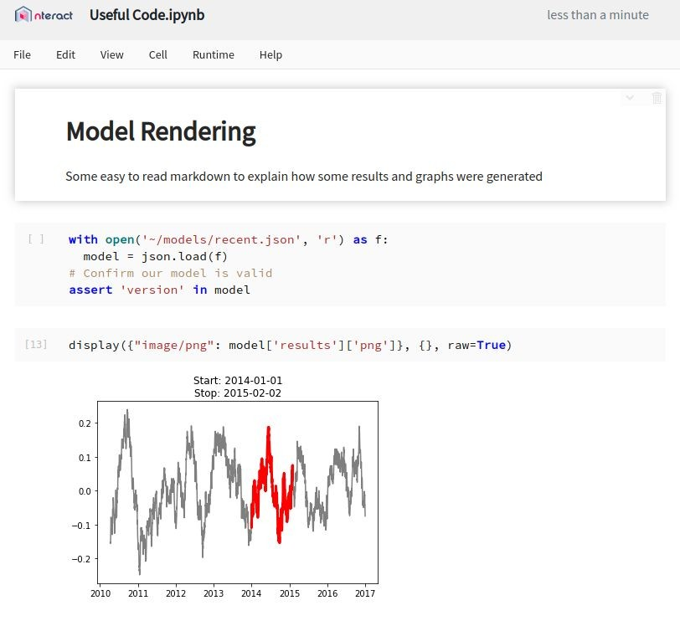

A Breakdown
Status / Save Indicator
Code Cell
Displayed Output

Slide 8
Wins.
Shareable
R and Python Kernels
Easy to Read
Documentation with Code
Outputs as Reports
Familiar Interface
Multi-Language

Slide 9
The Good.
Notebooks have several attractive attributes that lend themselves to particular development stories:
Quick iteration cycles
Expensive queries once
Recorded outputs
Easy to modify

Slide 10


Notebooks: A REPL (Read-Eval-Print Loop) Protocol + User Interface
Jupyter
UIs
develop
execute code
receive outputs
share
save / load
.ipynb
Jupyter Server
forward requests
Jupyter Kernel
R / Python / etc.
It’s more complex than this in reality

Slide 11
The Bad.
But they have drawbacks, some of which kept Notebooks from being used in wider development stories:
Lack of history
Difficult to test
Mutable document
Hard to parameterize
Live collaboration

Slide 12

Filling the Gaps

Slide 13





Open Source Projects
Contributed to by
https://github.com/nteract/nteract

Slide 14


A simple library for executing Notebooks with parameters
s3://output/mseal/
S3
EFS
parameterize & run
input
Papermill
store
run_1.ipynb
run_2.ipynb
template.ipynb
input notebook
run_3.ipynb run_4.ipynb
output notebooks

Slide 15
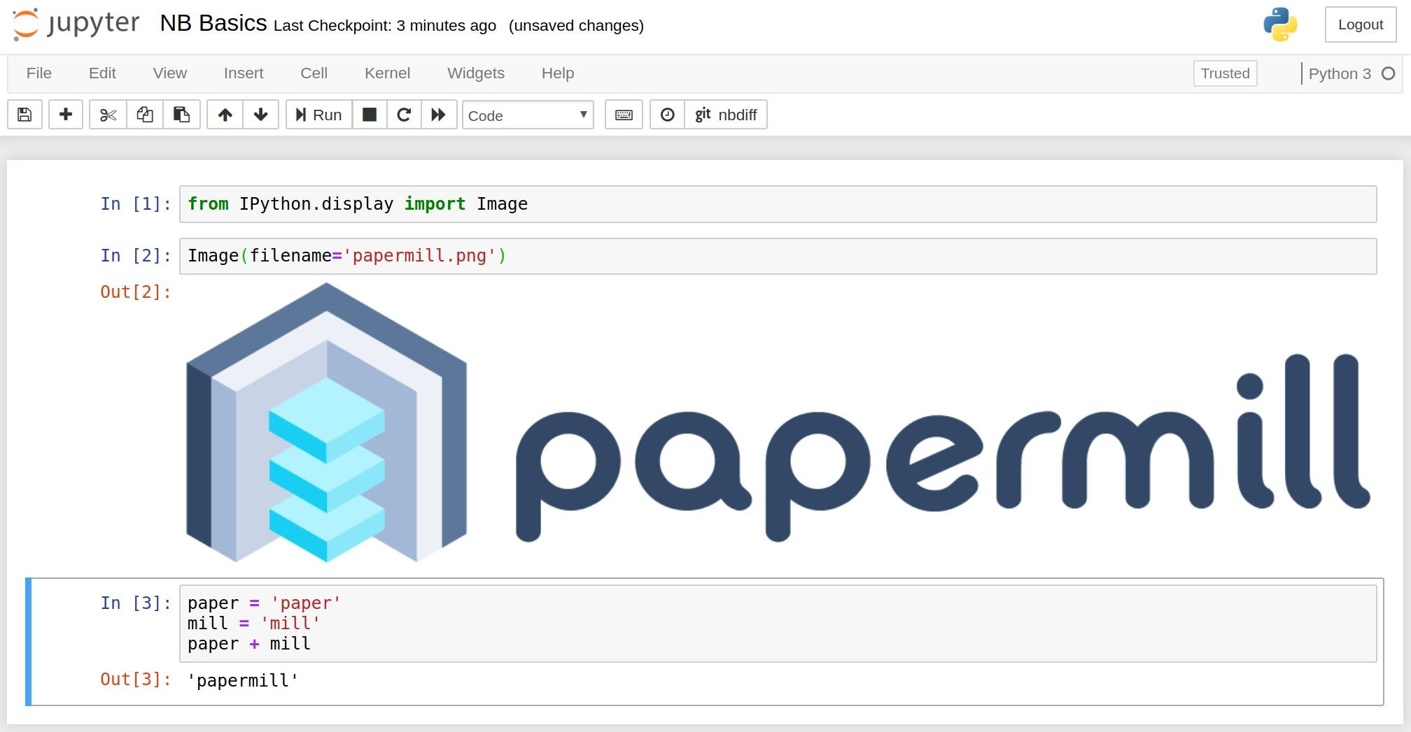
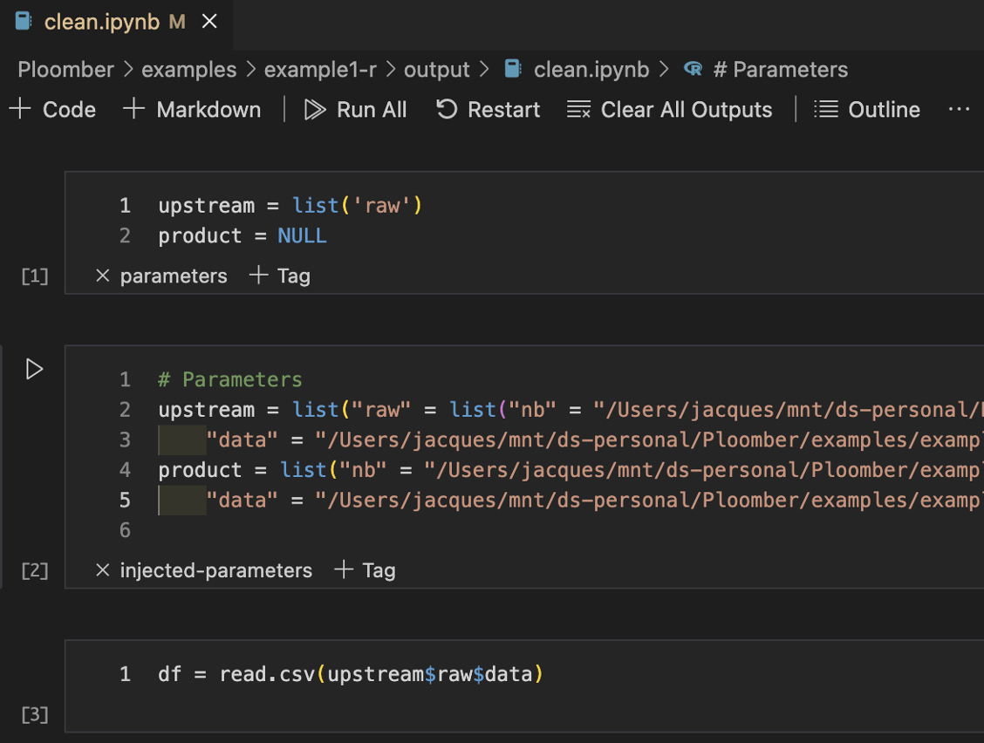
R
Python

Slide 16
Add Parameters
Import papermill as pm
pm.execute_notebook('input_nb.ipynb', 'outputs/20190402_run.ipynb',
{'region': 'ca', 'devices': ['phone', 'tablet']})
…
# Default values(Cell tagged as #parameters)
region = 'us' devices = ['pc']
date_since = datetime.now() - timedelta(days=30)
# Injected Parameters below #parameters cell
region = 'ca'
devices = ['phone', 'tablet']

Slide 17
Also Available as a CLI
# Same example as last slide
pm.execute_notebook('input_nb.ipynb', 'outputs/20190402_run.ipynb',
{'region': 'ca', 'devices': ['phone', 'tablet']})
…
# Bash version of that input
papermill input_nb.ipynb outputs/20190402_run.ipynb -p region ca -y '{"devices": ["phone", "tablet"]}'

Slide 18
Support for Cloud Targets
# S3
pm.execute_notebook( 's3://input/template/key/prefix/input_nb.ipynb', 's3://output/runs/20190402_run.ipynb')
# Azure
pm.execute_notebook( 'adl://input/template/key/prefix/input_nb.ipynb', 'abs://output/blobs/20190402_run.ipynb')
# GCS
pm.execute_notebook( 'gs://input/template/key/prefix/input_nb.ipynb', 'gs://output/cloud/20190402_run.ipynb')
# Extensible to any scheme

Slide 19
Changes to the notebook experience.
Adds notebook isolation
Immutable inputs
Immutable outputs
Parameterization of notebook runs
Configurable sourcing / sinking
and gives better control of notebook flows via library calls.

Slide 20
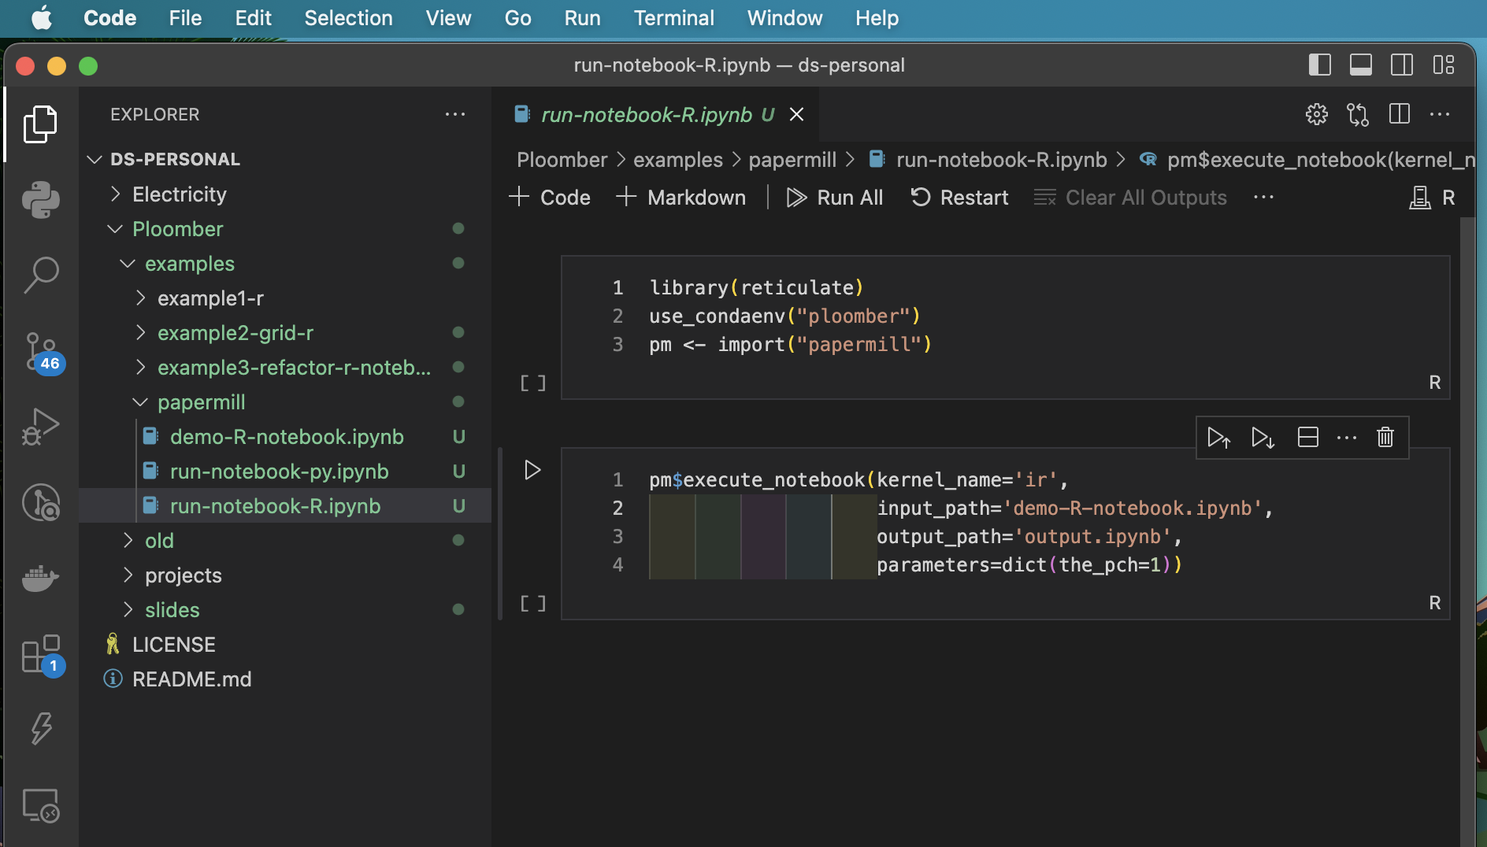
R Notebooks / Papermill Demo

Slide 21

Ploomber

Slide 22

Poor man's solution
•
Code project in a (long) single ﬁle
Problem: Not maintainable
No clear boundaries among tasks
Leads to unwanted interactions We need reproducible and
maintainable projects
•
•

Slide 23

Why bother about maintainability?
Without a lot of structure, we forget what we’ve done in the past, we can’t read each others’ work, and we can’t test whether what we’ve done is correct.¹
— Patrick Ball
Image: https://unsplash.com/photos/r6mBXuHnxBk
¹ https://hrdag.org/2016/06/14/the-task-is-a-quantum-of-workflow/

Slide 24
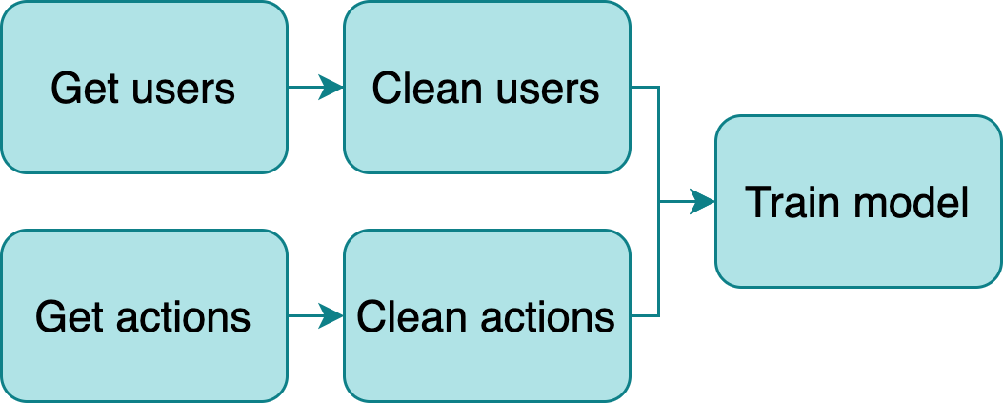
Build a data pipeline
•
Break down logic in small tasks
Outputs become inputs of downstream
tasks
New challenge: Manage structure
Multiple ﬁles
Route outputs
Orchestrate execution
•
•

Slide 25

Current approach: Workﬂow managers
•
Frameworks to develop pipelines (Make, Airﬂow, Luigi, etc)
Problems:
Learn a new tool
Write pipeline code
Adds unnecessary complexity
•
Image: https://unsplash.com/photos/l090uFWoPaI

Slide 26
Ploomber
Adheres to a convention over conﬁguration philosophy, to allows us to write pipelines with a focus on usability.
Three conventions:
Each task is a script
Scripts declare dependencies via an upstream variable
And outputs via a product variable

Slide 27
Main features
•
Python, R and SQL⁴ supported⁵
Parametrized pipelines with auto-generated CLI Testing (i.e., run data tests upon task execution) Debugger integration (pdb and ipdb)
•
•
•
Any database with a DBAPI 2.0 client or compatible with SQLAlchemy is supported
Languages that have Jupyter kernels are supported with a few limita9ons

Slide 28
Integration with Jupyter
•
Scripts open as notebooks³
(Temporary) cell injection
Ensures no hidden state by running
ploomber build
•
•
³ Thanks to jupytext! https://github.com/mwouts/jupytext

Slide 29
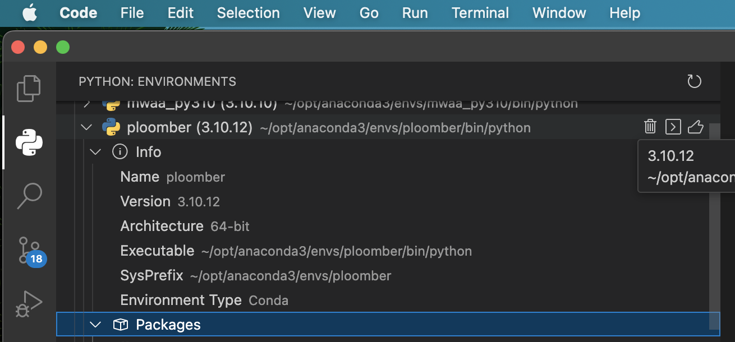
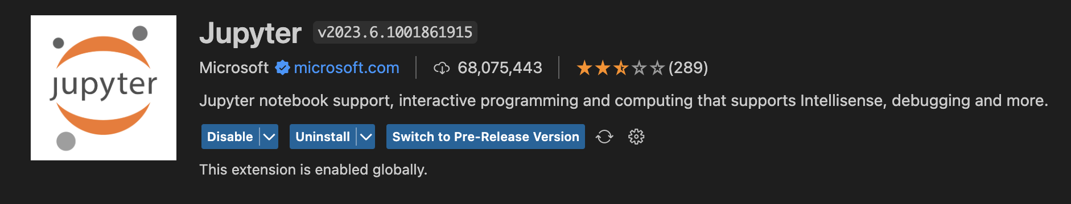
Environment Setup: Install Ploomber + enable Running R notebooks in VSCode
Create a python 3.10 environment
> pip3 install ploomber
Install the Jupyter extension in VsCode
R Run: >install.packages("IRkernel")
R Run: >IRkernel::installspec()
Create a new file with .ipynb file extension and open it
Select the R kernel to use.
Run r your R Code in it.

Slide 30
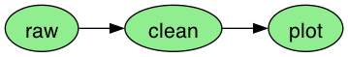
R workﬂow Example1
1. Input
3. Result
raw.R
clean.R
plot.Rmd
output/
raw.csv
raw.ipynb
clean.csv
clean.ipynb
plot.ipynb
2. Execute
ploomber build --entry-point .

Slide 31
R example 1: “pipeline.yaml”
tasks: # list of tasks
# use plain R scripts
- source: raw.R # write iris data to CSV
product:
# this is the executed version of your script
# you can review tables and charts here
nb: output/raw.ipynb # output notebook can also be html
data: output/raw.csv
- source: clean.R # clean iris data
product:
nb: output/clean.ipynb # output notebook can also be html
data: output/clean.csv # cleaned data
# R markdown files also supported
- source: plot.Rmd # plot iris data
product:
nb: output/plot.ipynb
# Quarto does not work yet :(
# - source: plot2.Qmd
# product:
# nb: output/quarto.ipynb

Slide 32
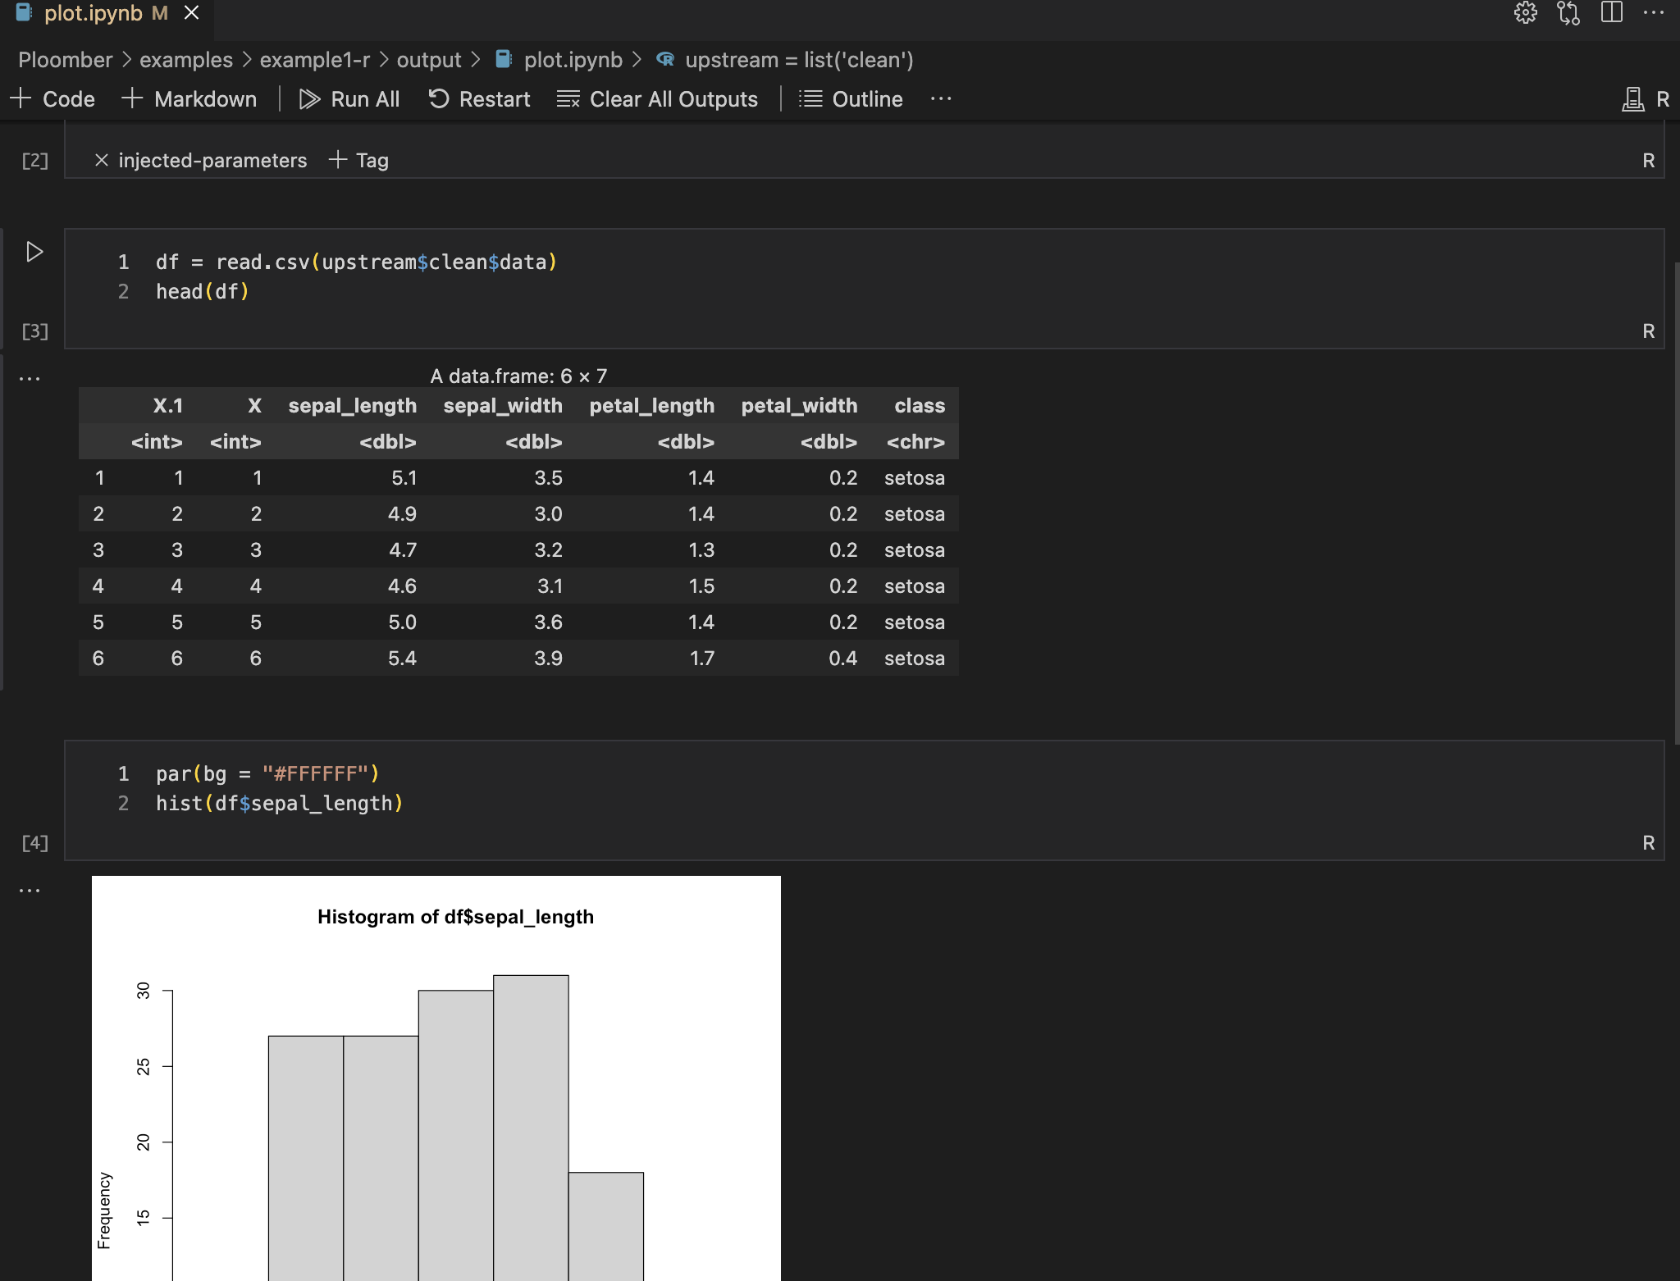
Tasks as notebooks
•
Tasks are converted to notebooks (.ipynb) before execution²
No need to write code to save tables or charts
Generate logs for each execution
•
•
² Thanks to papermill! h2ps://github.com/nteract/papermill

Slide 33
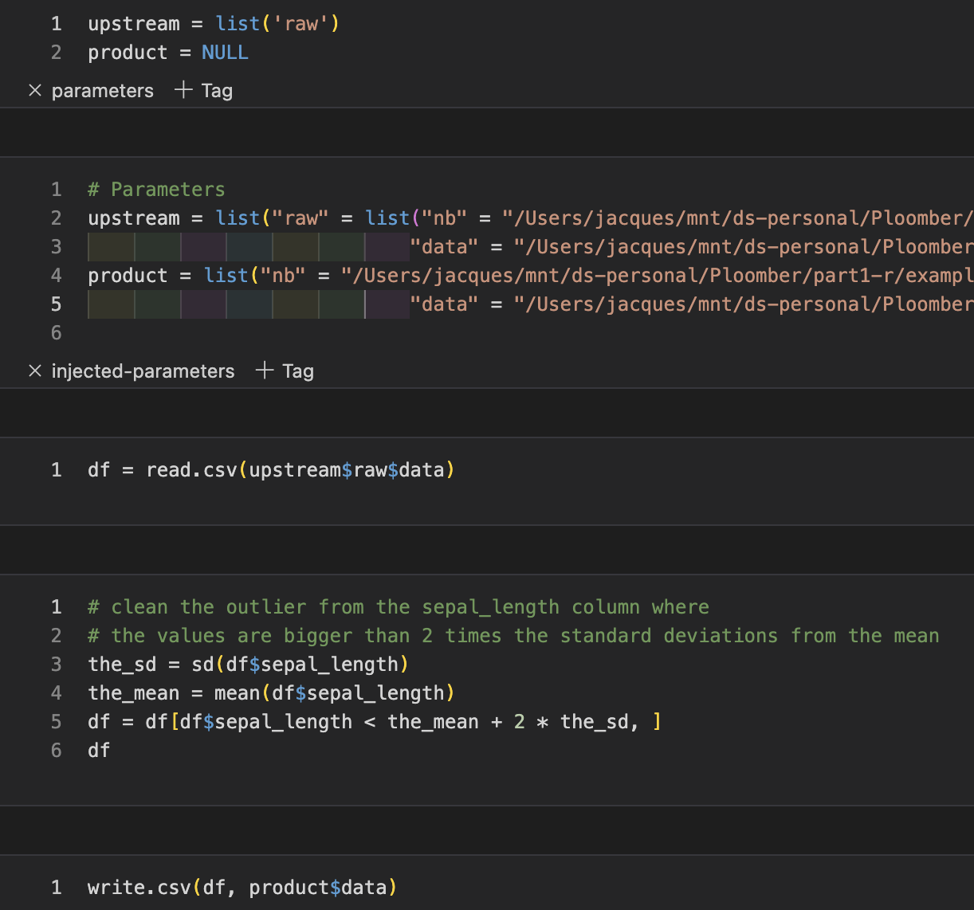
Tasks: R scripts/notebooks
clean.R
clean.ipynb
# + tags=["parameters"]
upstream = list('raw')
product = NULL
# -
df = read.csv(upstream$raw$data)
# clean the outliers from the sepal_length
# the values are bigger than 2 times the standard deviations from the mean
the_sd = sd(df$sepal_length)
the_mean = mean(df$sepal_length)
df = df[df$sepal_length < \
the_mean + 2 * the_sd, ]
df
write.csv(df, product$data)

Slide 34
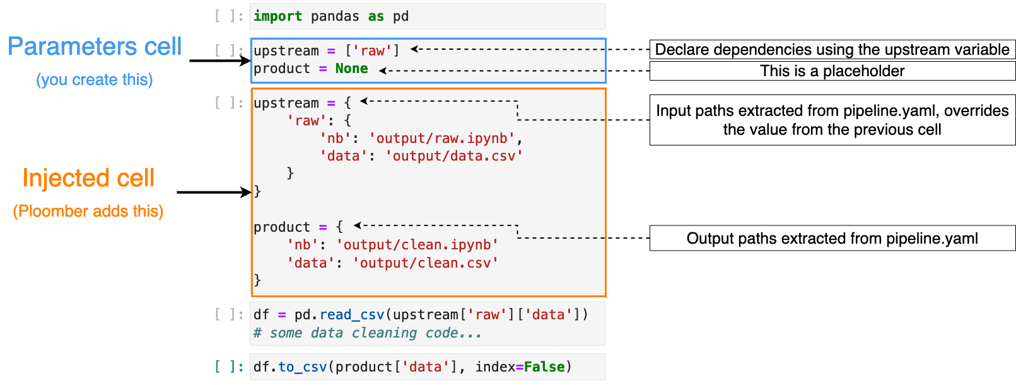
Cell injection concepts (Python)

Slide 35
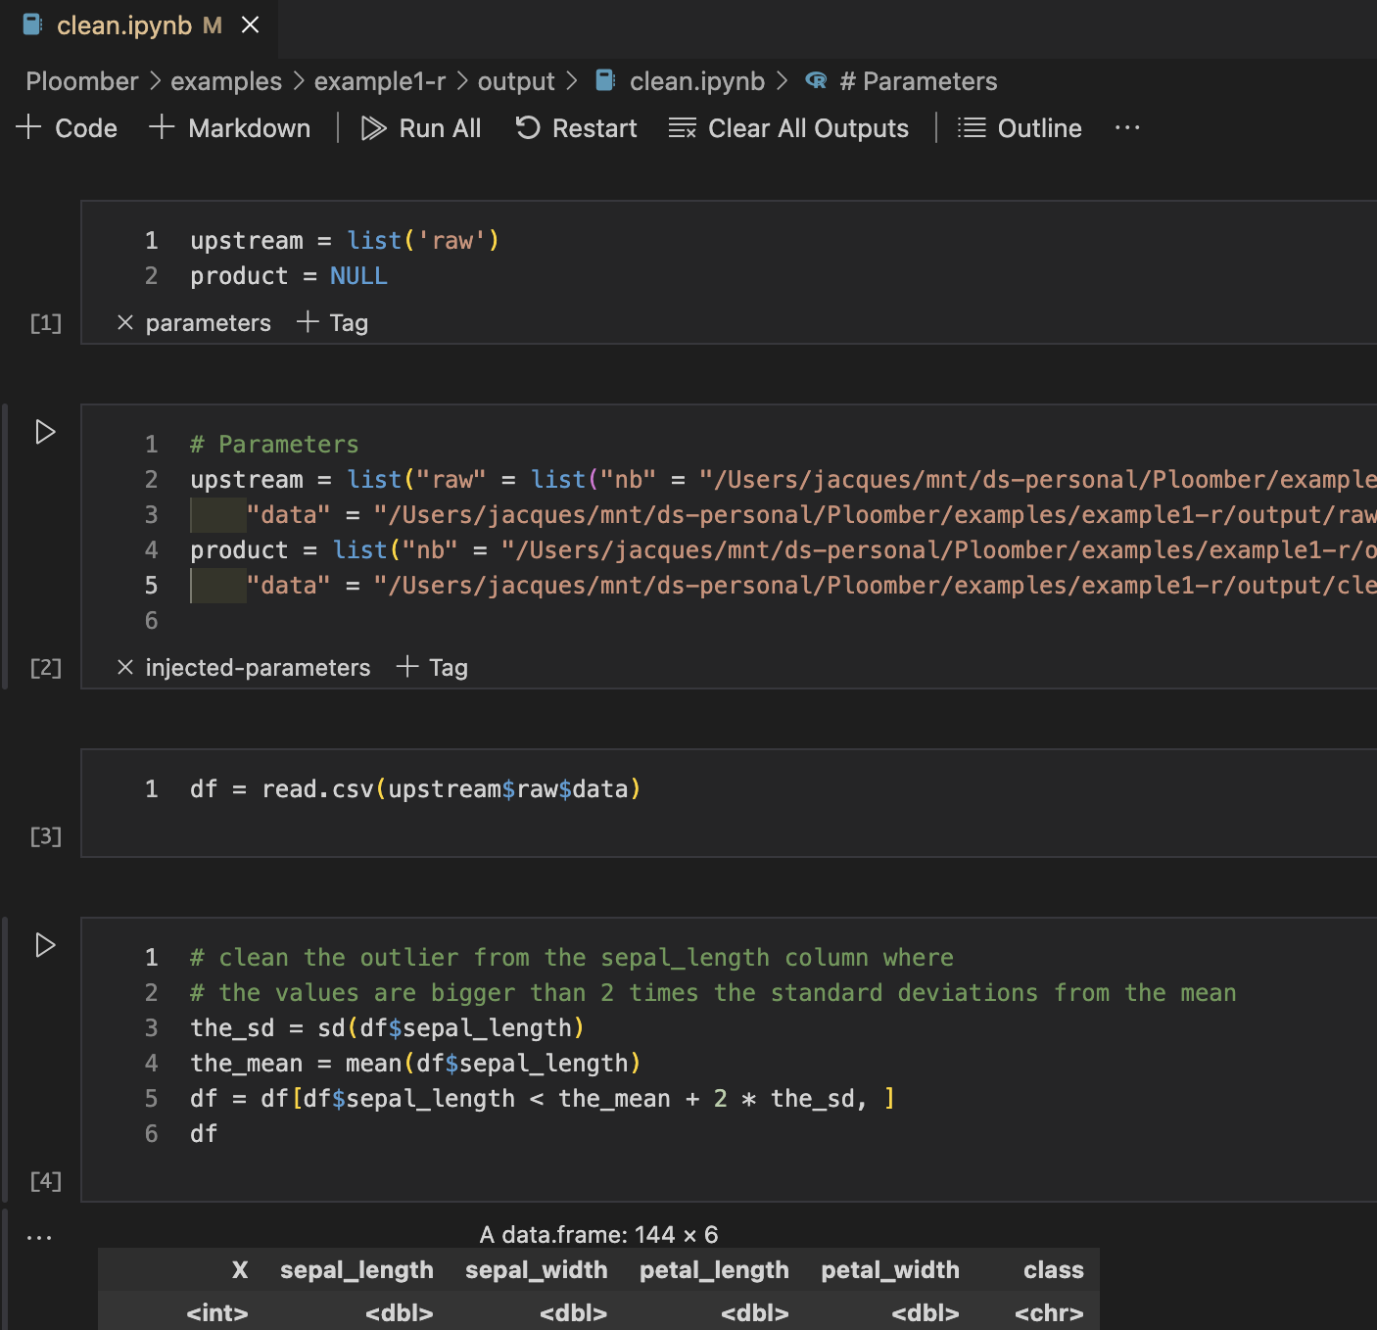
Cell injection: R notebook
See ‘parameters’ and ‘injected-parameters’ tags
Because the cleaning of the data are dependent on the raw data (upstream of ‘raw’ (raw.R) was requested, and upstream was replaced with the product output of raw.

Slide 36
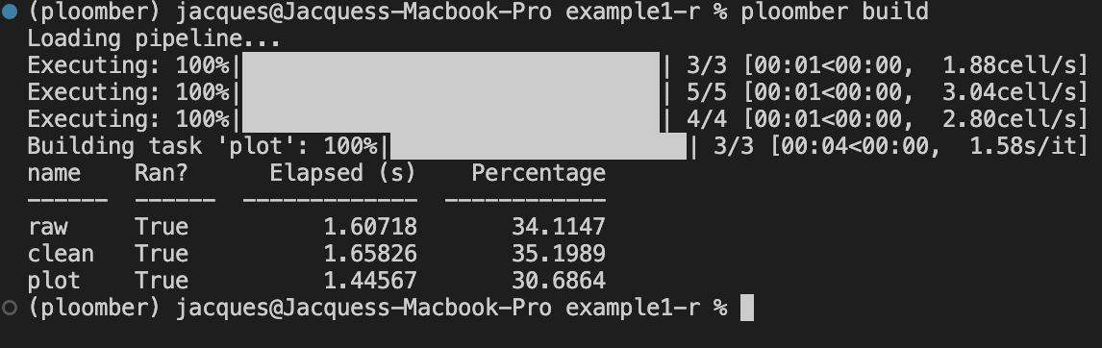
Build process
Extract upstream and product
Determine execution order using extracted upstream dependencies
Inject code. Replace the list of dependency names with a map of names to products
Execute the pipeline (skips up-to-date tasks)

Slide 37
Build process
Extract upstream and product
Determine execution order using extracted upstream dependencies
Inject code. Replace the list of dependency names with a map of names to products
Execute the pipeline (skips up-to-date tasks)

Slide 38
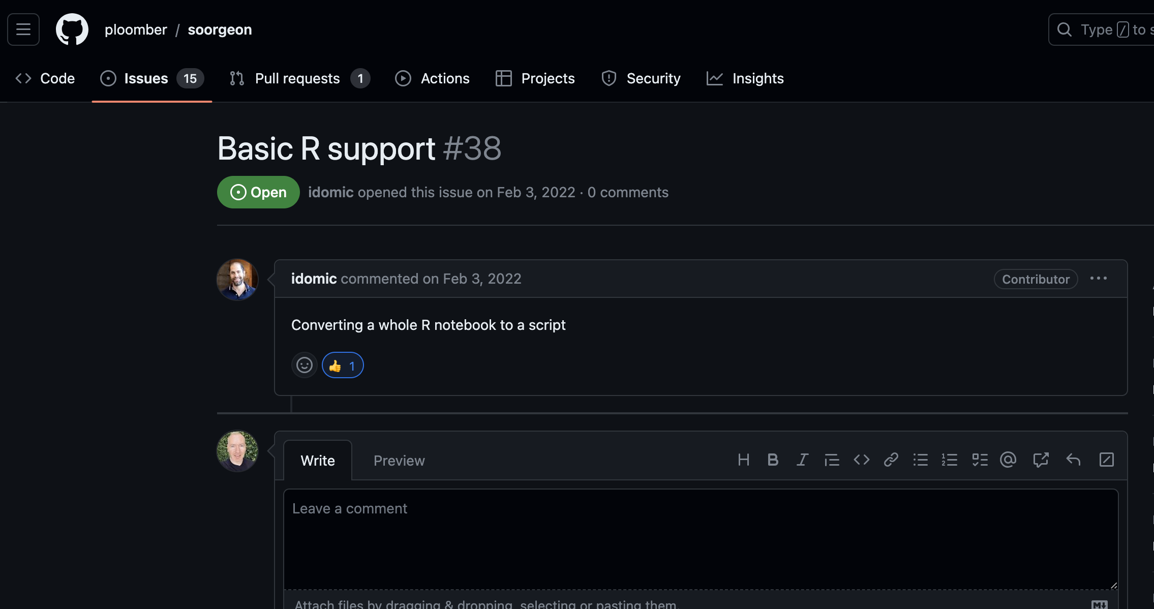

Slide 39
Resources
Install: pip install ploomber
For updates/questons/feedback, follow me on LinkedLn:
https://docs.ploomber.io/en/latest/
https://docs.ploomber.io/en/latest/user-guide/r-support.html
Examples: github.com/ploomber/projects Website: ploomber.io
This presentation: blancas.io/talks/jupytercon-20.pdf
•
•
•
•

Slide 40
Thanks for watching!

